Slide 1


INSIGHTS ON PARALYMPICS 2024
GROUP 13
TEAM MEMBERS:
KHUSHI LEKHWAR
LIPIKA BAGAI
SHRASTI DWIVEDI
MAHESH PATEL

Slide 2
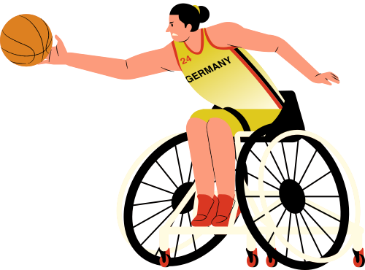
KEY QUESTIONS OF INTEREST
Question 1
Question 2
Question 3
What is the participation and performance distribution of each country across different sports in the 2024 Paralympics?
Does the performance ratio (medals/participants) vary by gender, and is it influenced by GDP?
Is there a relationship between medal positions and gender across countries?

Slide 3

DATA COLLECTION & APP UTILITY
THE DATA COLLECTION INCLUDED:
PARALYMPICS 2024 MEDAL TALLY
SPORTS WISE PARTICIPATION OF EACH COUNTRY
GDP DATA OF ALL COUNTRIES (2022)
HOW IS THIS APP USEFUL:
It helps analyze how economic factors may influence a country’s investment in Paralympic sports and overall performance.
Identifying sports that receive less attention or have lower medal counts can highlight areas for development and inspire targeted support for underrepresented sports.

Slide 4
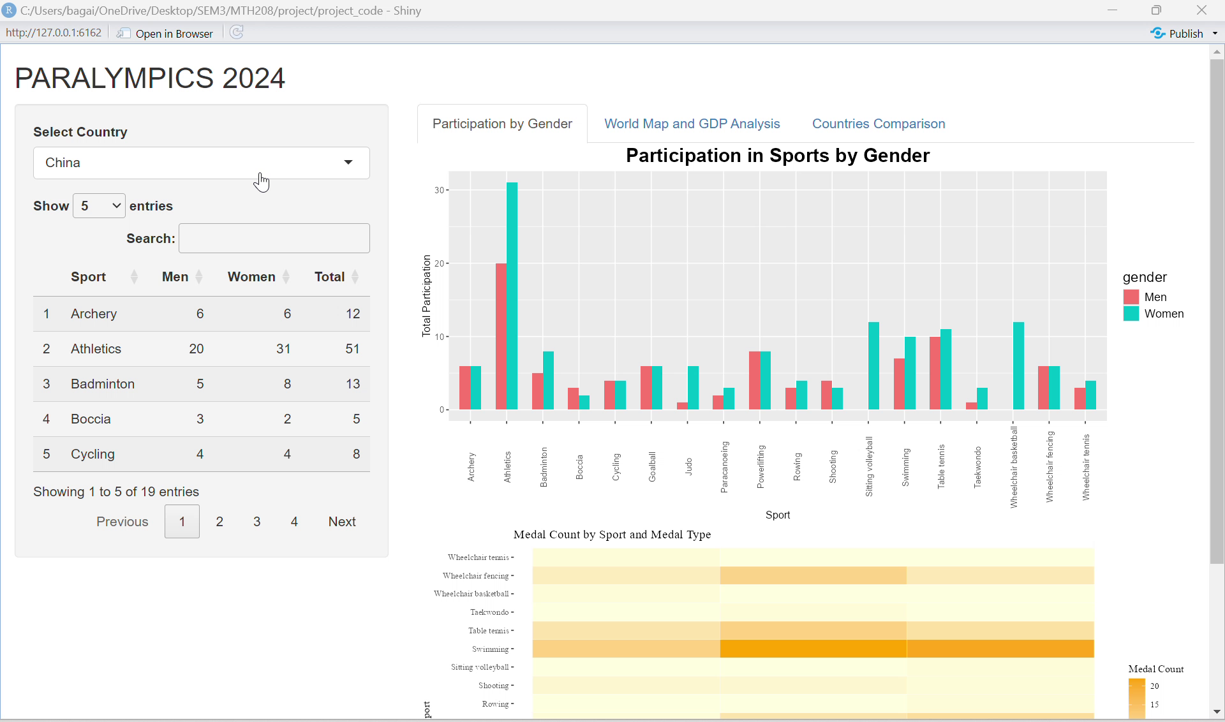
https://drive.google.com/file/d/1ZxYESb0CicOQ8x5AQ_FnaUo74TOXfuKq/view?usp=sharing

Slide 5

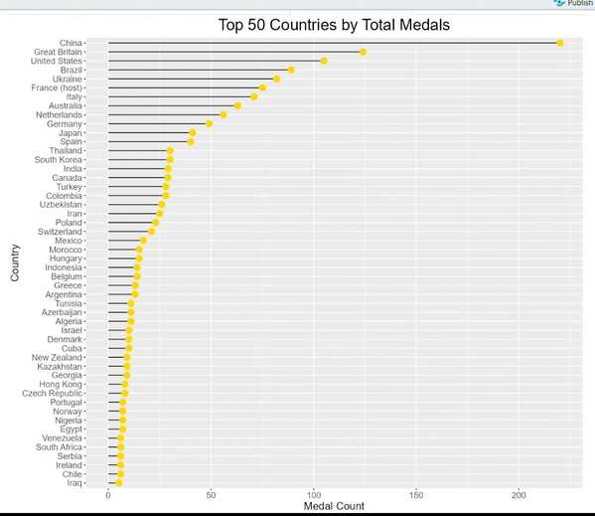
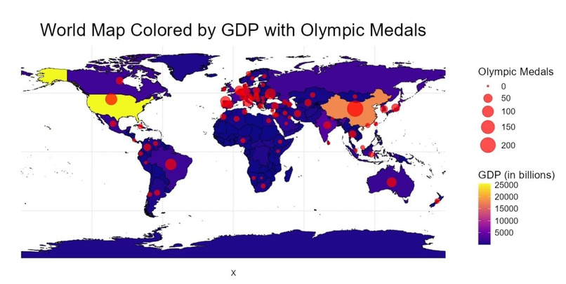
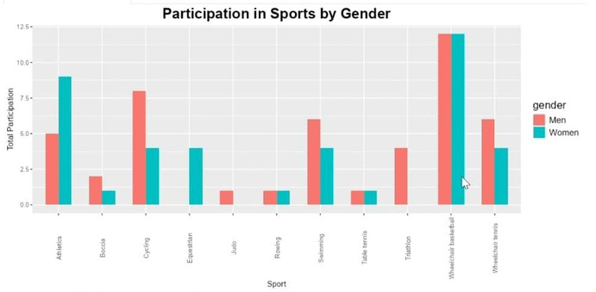
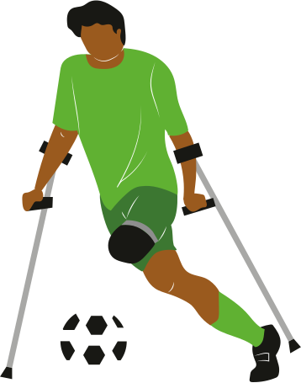
VISUALIZATIONS
Countries are based on their GDP level .
Comparative visualization for medal count of each country
Comparative lollipop chart for each medal type and total medals.
Gender representation within each sport.
INSIGHTS
This visualization showcases the number of male and female participants in each sport within a country.
Observe gender diversity within each sport.
INSIGHTS
High medal counts and better female medal to participation ratio in high-GDP countries
INSIGHTS
Observe medal distribution and spot high-performing nations

